Slide 1
POVERTY AND POLLUTION IN TENNESSEE
Robert Parker//da09

Slide 2
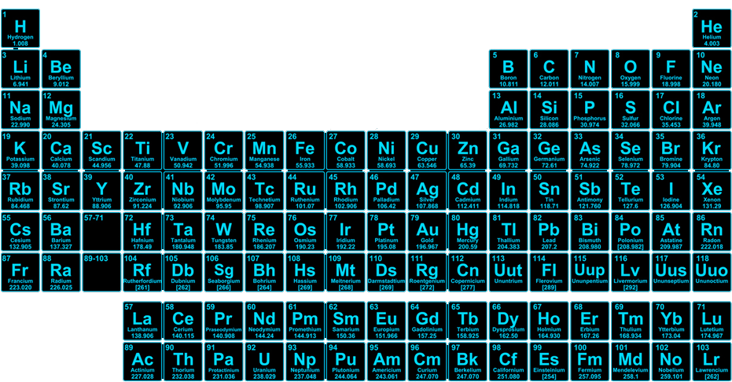

Slide 3
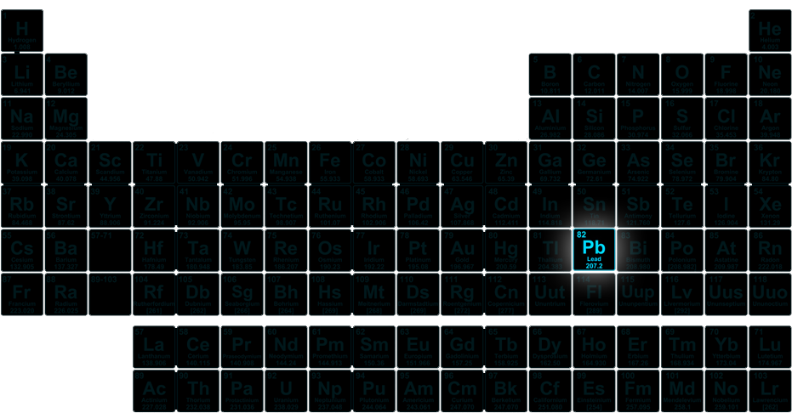

Slide 4
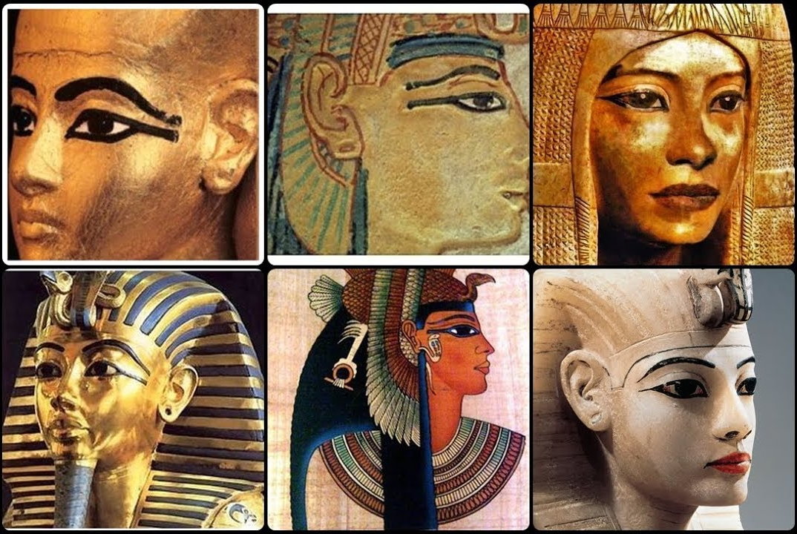
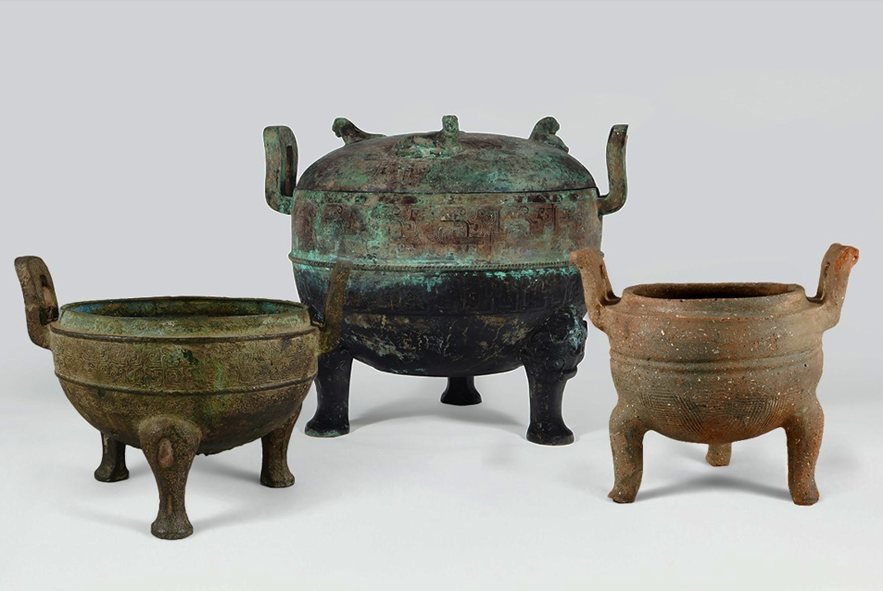
THE HISTORY OF LEAD
Ancient Egypt
Ancient China
The ancient, smokey eye makeup known as “Kohl” is made from lead ores
These ritual cauldrons were made from an alloy containing copper, tin, and lead

Slide 5
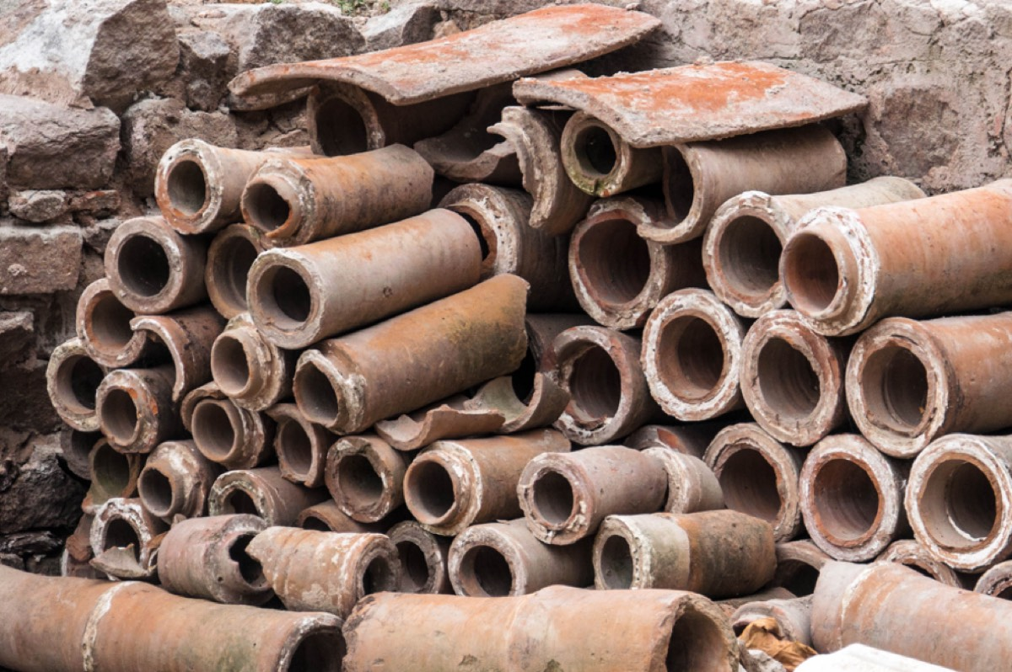
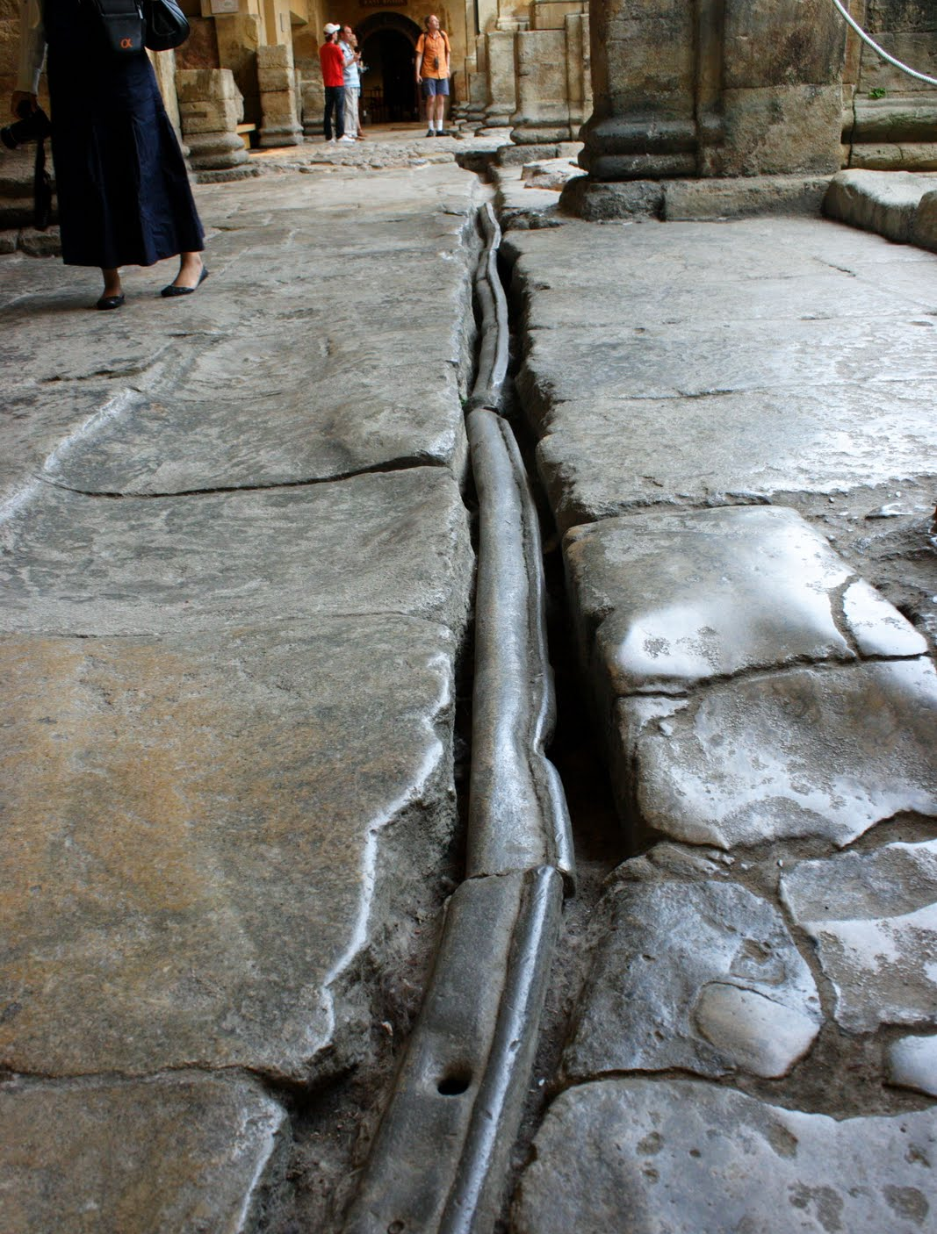
ANCIENT ROME
At its peak, the Roman civilization was producing 60,000 to 80,000 tons of lead per year

Slide 6
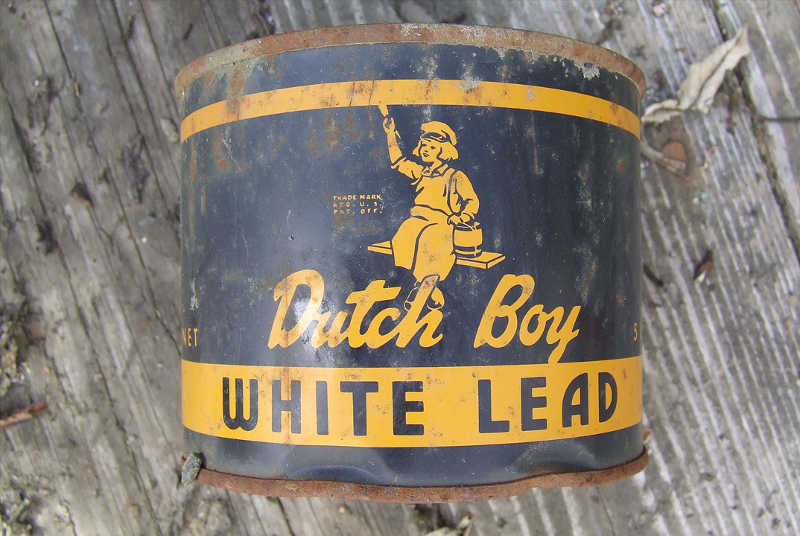
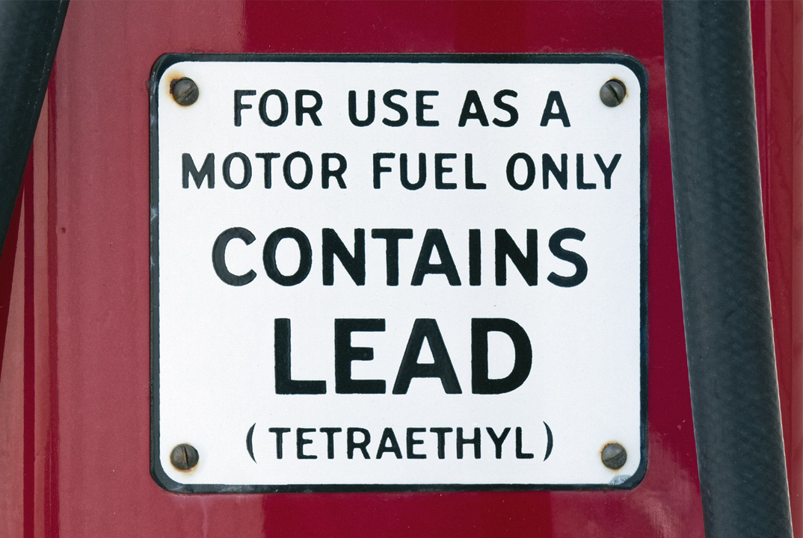

MODERN SOURCES OF LEAD
Lead Paint
Leaded Gasoline
Lead additives accelerate drying and increases durability
Tetraethyllead boosts octane rating and improves performance and fuel economy

Slide 7




MODERN SOURCES OF LEAD
Cosmetics
Candy
99% of externally applied cosmetics contain up to 10ppm of lead
Lead acetate was used as a sweetener, and ink used in candy wrappers can contain lead

Slide 8
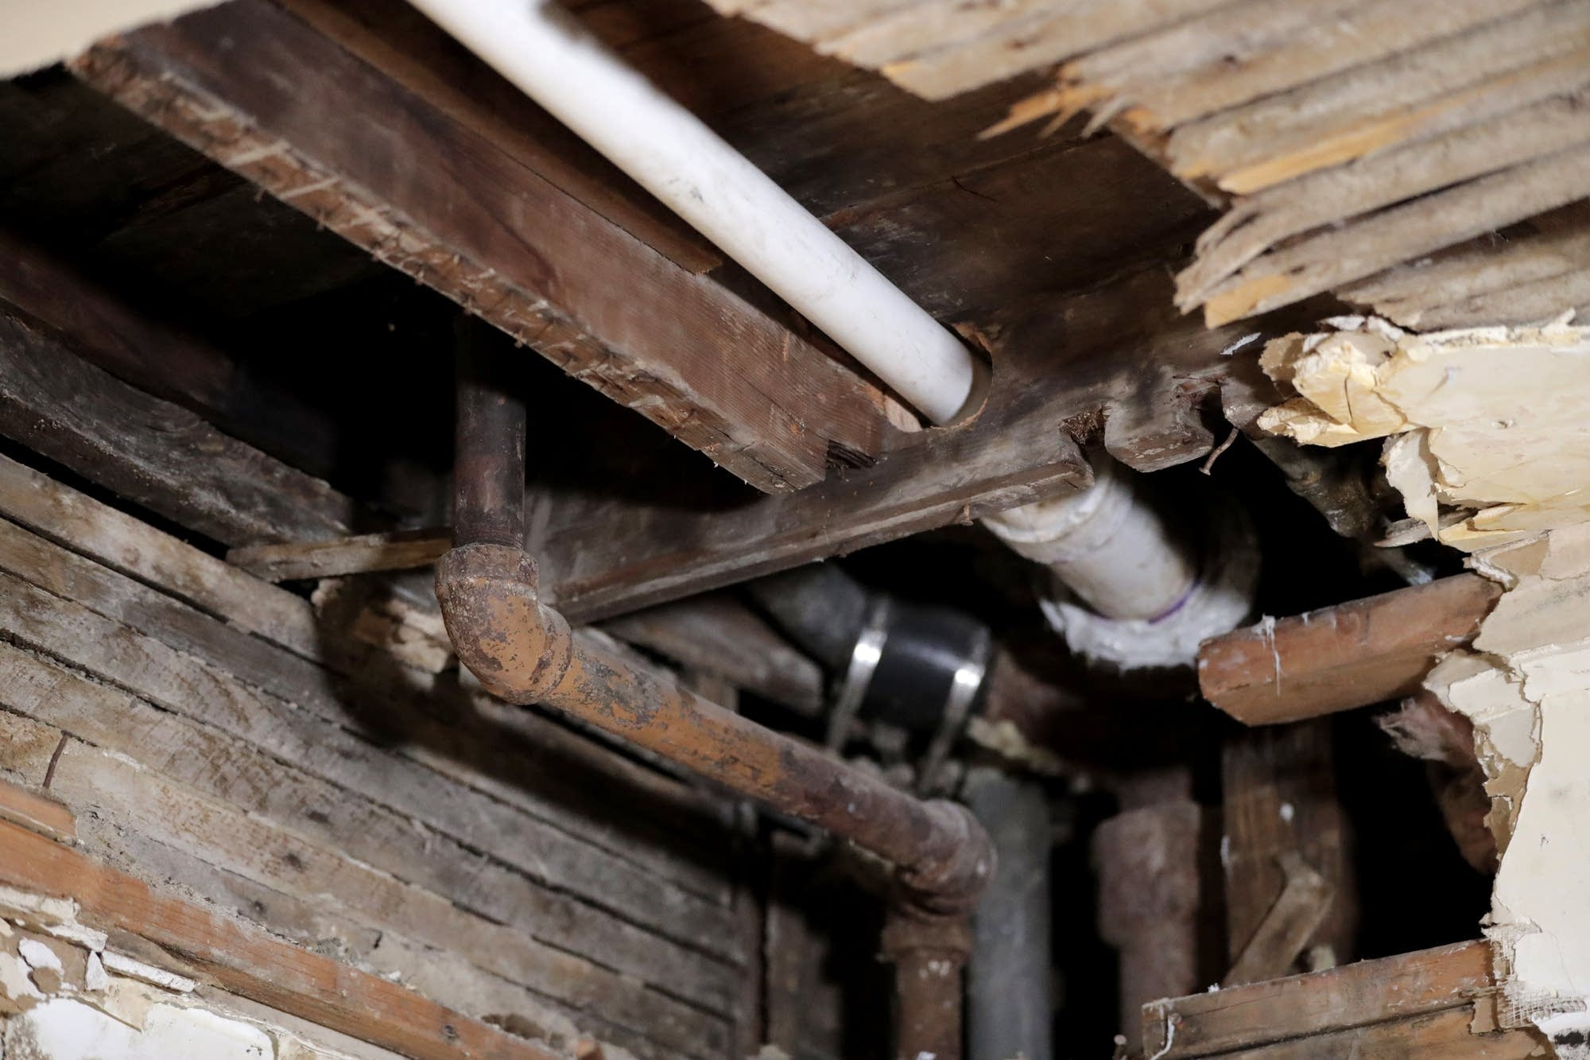
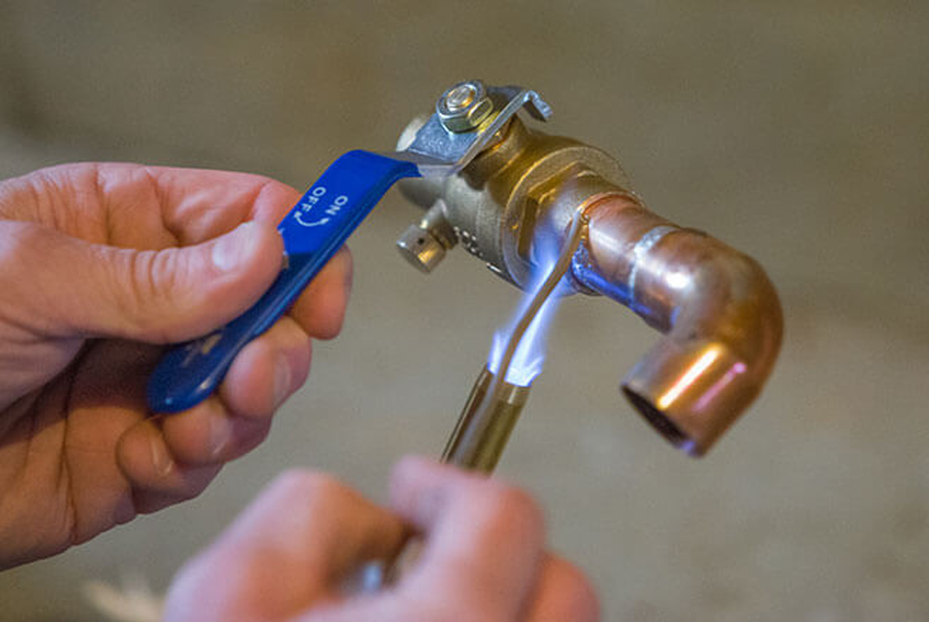


MODERN SOURCES OF LEAD
Lead Pipes
Lead Solder
The EPA estimates that 9.2 million lead water pipes are still in use
Joining copper pipes with lead solder was the industry standard until 1986

Slide 9
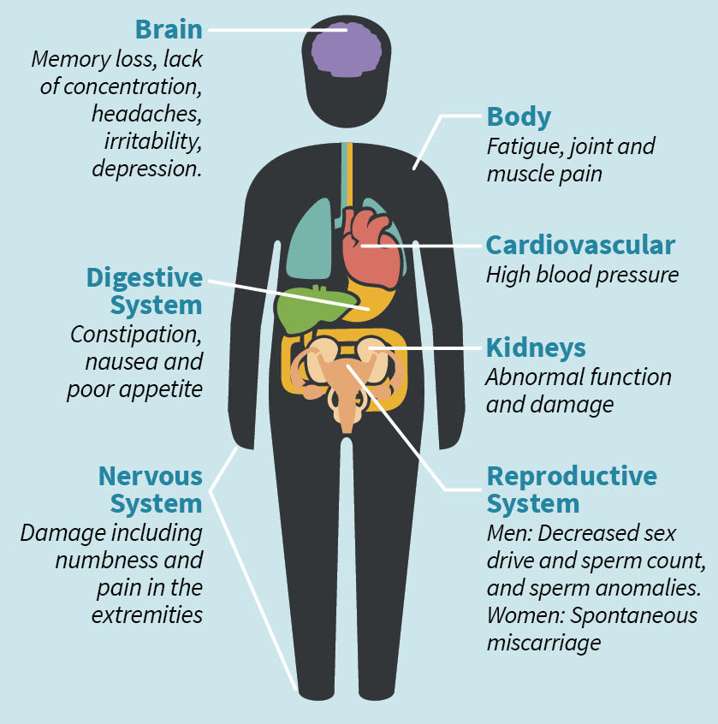
Memory Loss
Lack of Concentration
Irritability
Depression

Slide 10
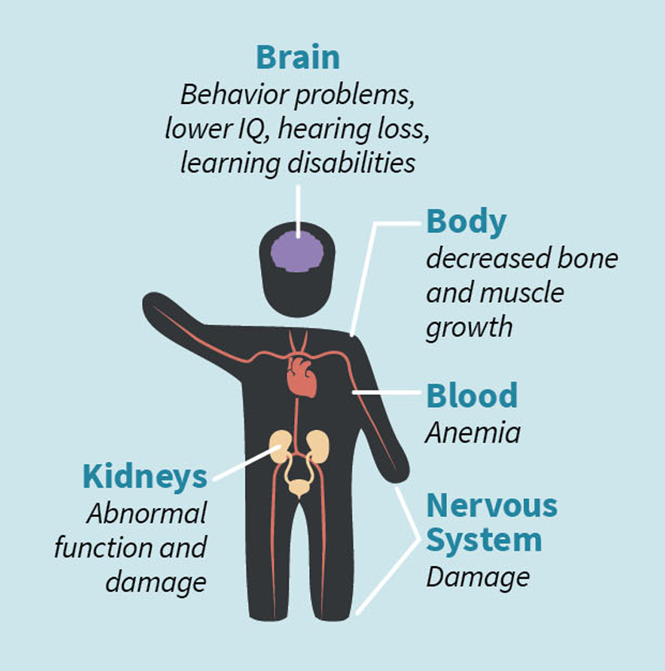
Behavior Problems
Lower IQ
Cognitive Dysfunction
Hearing Loss

Slide 11
Elevated Blood Lead Levels (EBLL)
Blood lead concentrations above 5_{μg/dL} (micrograms per deciliter) are considered elevated

Slide 12
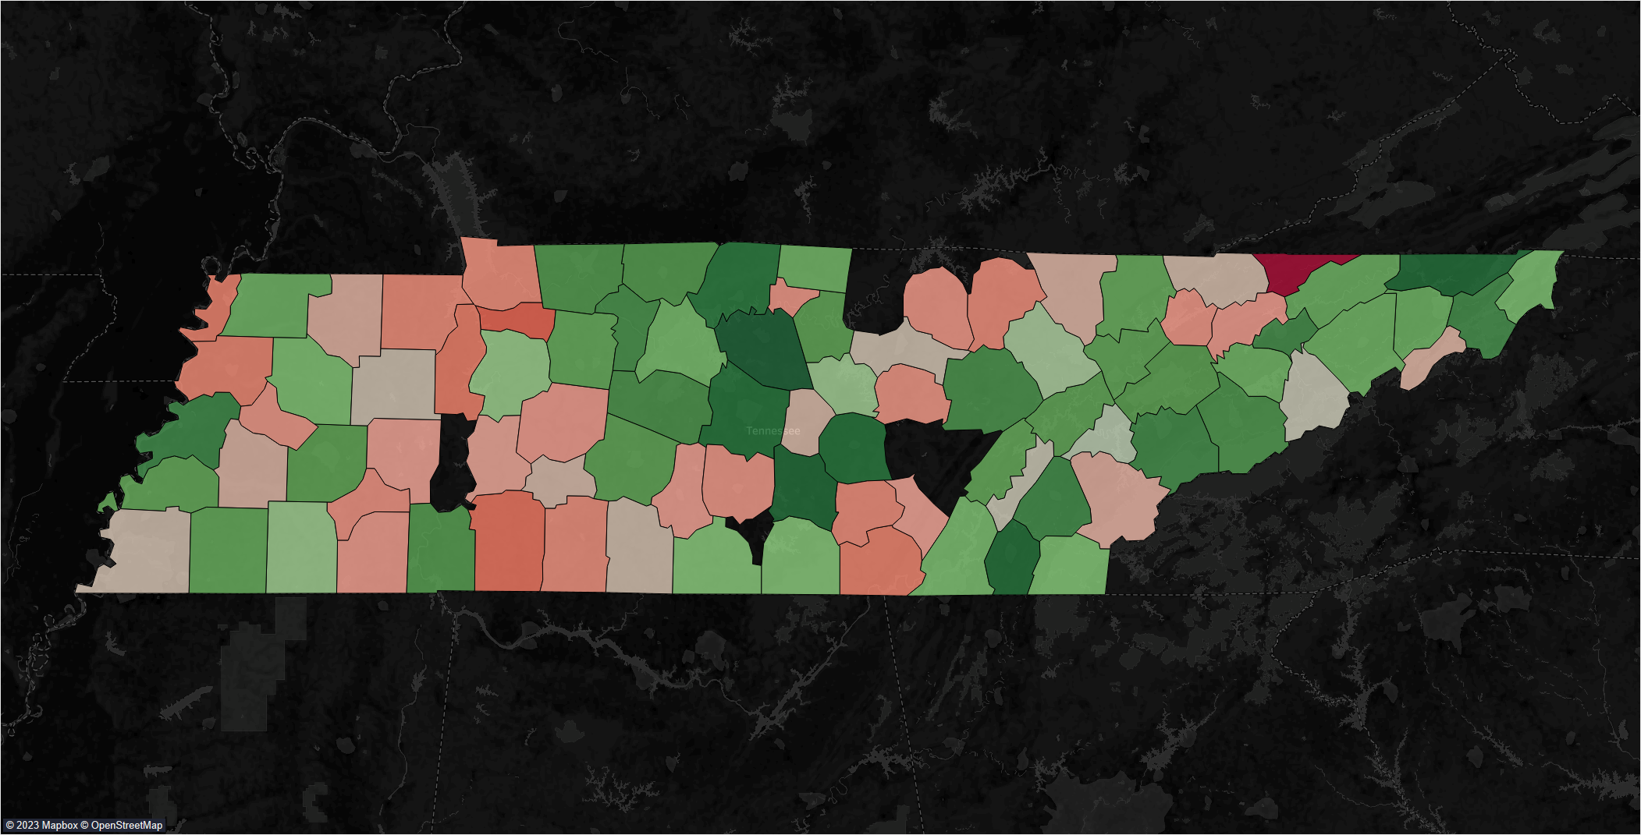
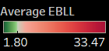

Slide 13
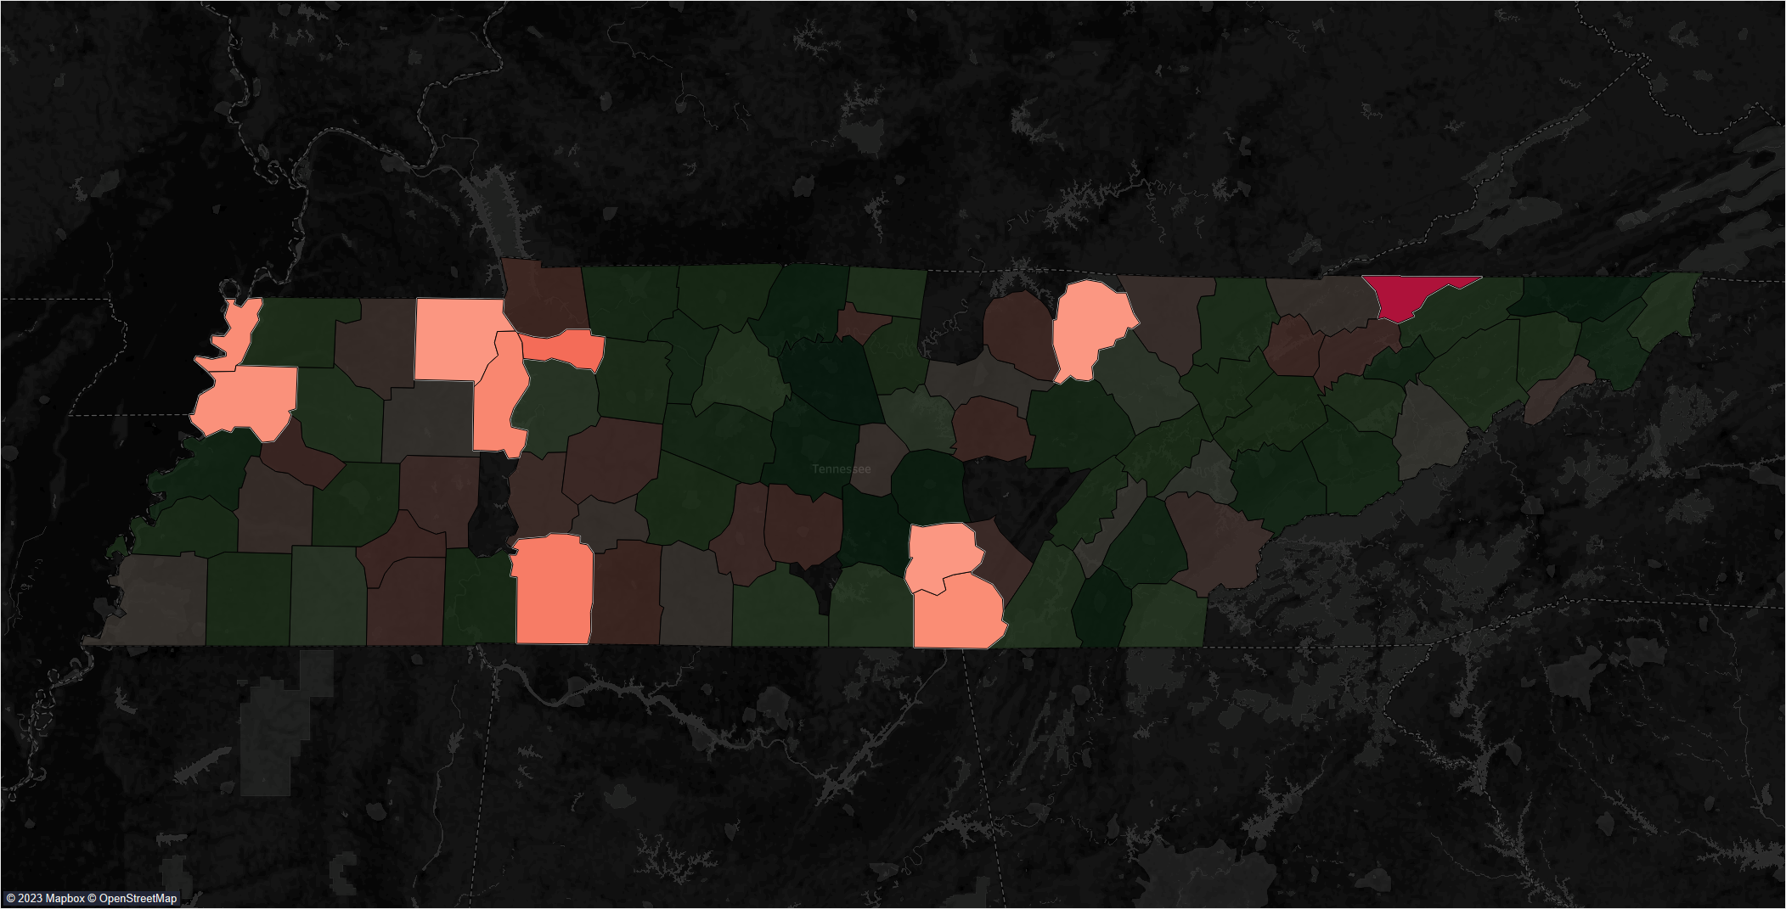

Slide 14
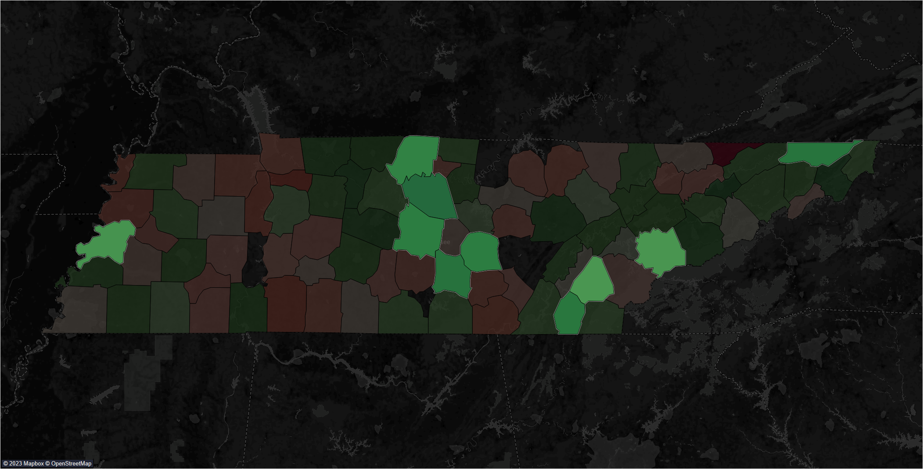

Slide 15
High EBLL
Low EBLL
Median Income | $22,209 | $28,447
Population | 18,390 | 126,576
Poverty Rate | 19.8% | 13.7%

Slide 16
Average EBLL per 1,000 Children
6.9

Slide 17
Infant Mortality per 1,000 Births
7.2

Slide 18
Disabilities
6.4%
0.6%
Cognition
Hearing

Slide 19
Premature Deaths per 100,000
493.4

Slide 20
Housing Dangers
DPI
Pre 1979 Homes

Slide 22
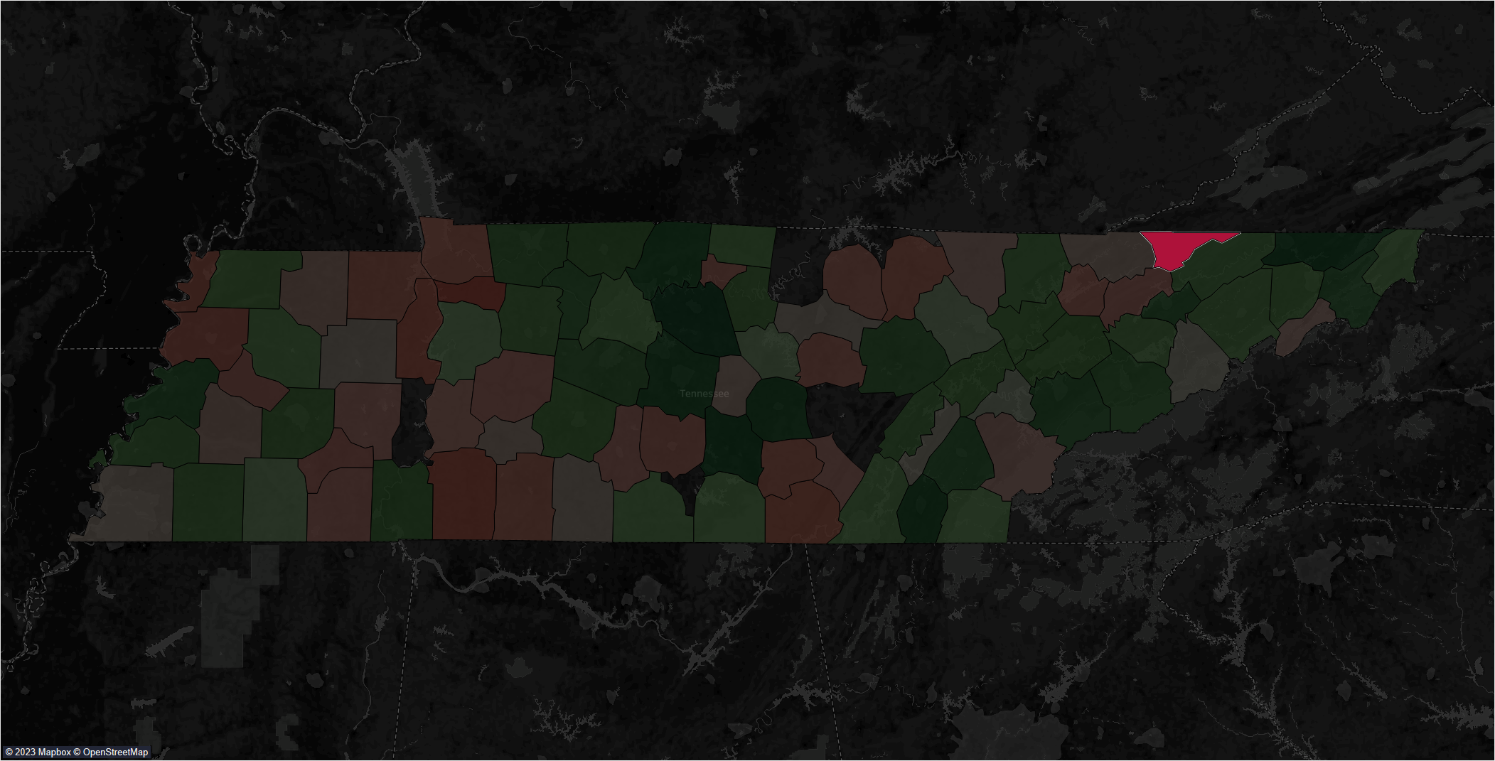

Slide 23
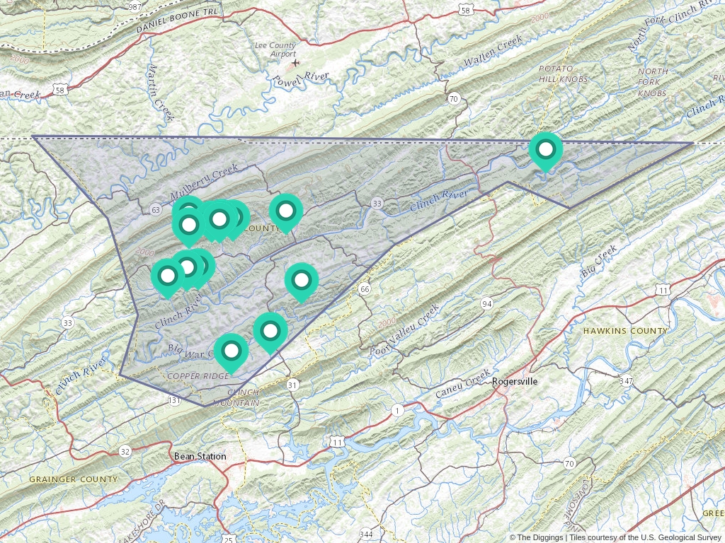

Slide 24
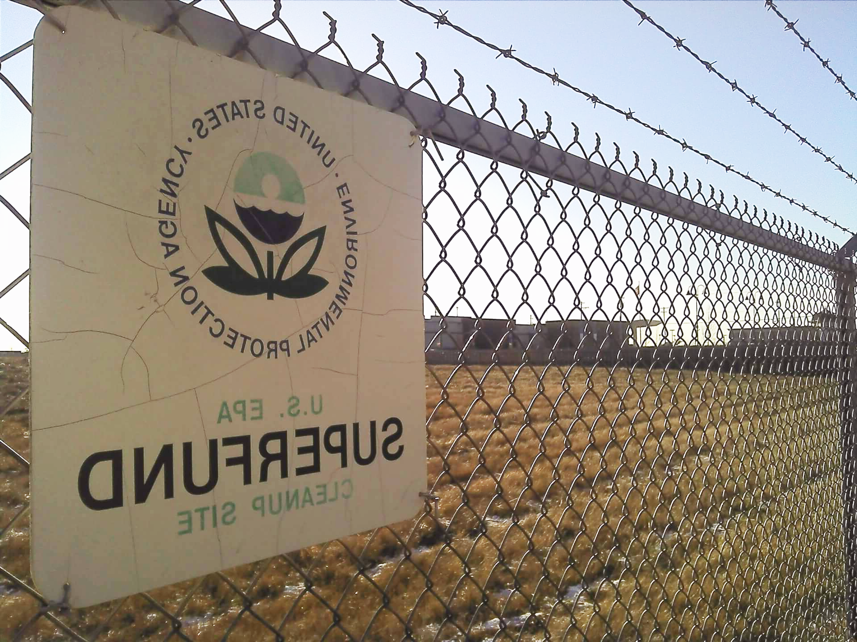

SUPERFUND SITES
The Superfund program grants the EPA the funds and authority to clean up contaminated sites when there’s no viable responsible party

Slide 26


Slide 27
13
Superfund Sites
32
Superfund Sites

Slide 28
Lead Abatment Tax Credits
Ohio
Massachusetts
Rhode Island
$10,000 max credit per taxpayer
$1,500 per housing unit
$1,500 per housing unit for mitigation, $5,000 or abatement

Slide 29
Thank you!
Robert Parker//da09

